Slide 1
E-commerce-API

Slide 2
Our Team
Ahmed Mohamed Zakaria
Shadia Mohamed Gheitas
Yasser Omara Emam
Hazem Hassan Mohamed

Slide 3
Idea
This project is a comprehensive web-based e-commerce platform that enables users to create an account or log in, browse products stored in the database (such as laptops, mobile phones, and cameras), add items to their shopping cart, and securely complete purchases through integrated payment gateways like Stripe.
The platform features a full admin dashboard where administrators can manage products, categories, and orders efficiently.
The system will be built using an N-Tier architecture, separating the application into distinct layers (User Interface, Business Logic, and Data Access) to enhance maintainability, scalability, and testability. Technologies such as Repository Pattern, Unit of Work Pattern, Dependency Injection, Entity Framework Core, and ASP.NET Identity will be used to ensure a clean, modular, and secure development approach.

Slide 4
Objective
The goal is to build a scalable, maintainable, and secure e-commerce web application focused on selling electronics. The platform will simplify the online shopping experience, ensure smooth and secure payment processing through Stripe, and adopt a clean architecture by applying the Separation of Concerns principle via an N-Tier architecture.
Modern technologies such as Bootstrap for responsive UI design, Entity Framework Core for database management, Stripe API for secure payments, and Azure for cloud hosting will be utilized. Design patterns like the Repository Pattern and Unit of Work Pattern will be implemented to enhance development efficiency, maintainability, and scalability.

Slide 5
Our Services
We provide comprehensive solutions tailored to meet our clients' needs, ensuring efficient and effective outcomes.
Our team offers innovative strategies and expert support to help your business grow and succeed.

Slide 6
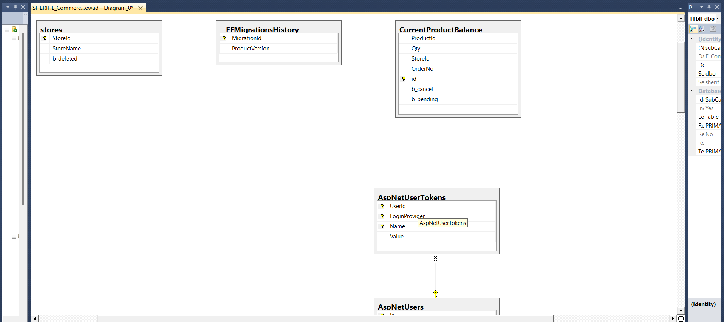
erd

Slide 7
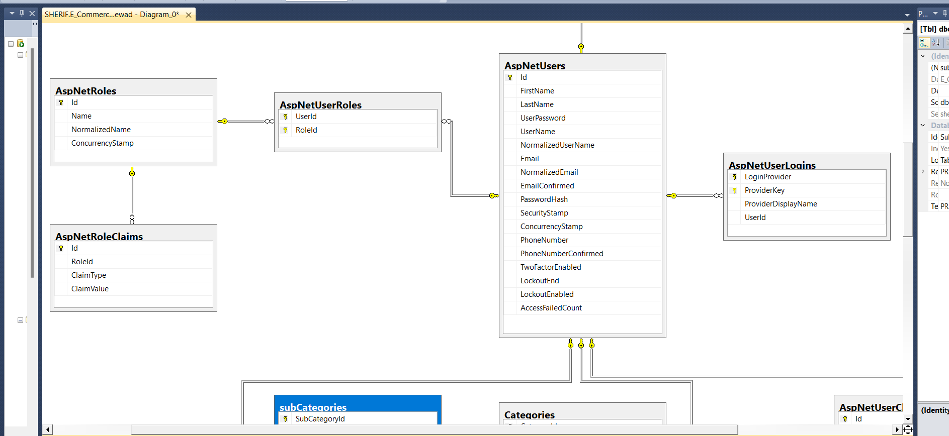

Slide 8
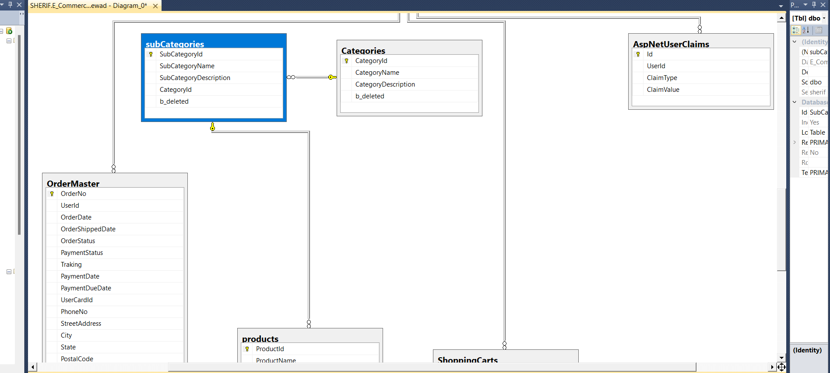

Slide 9
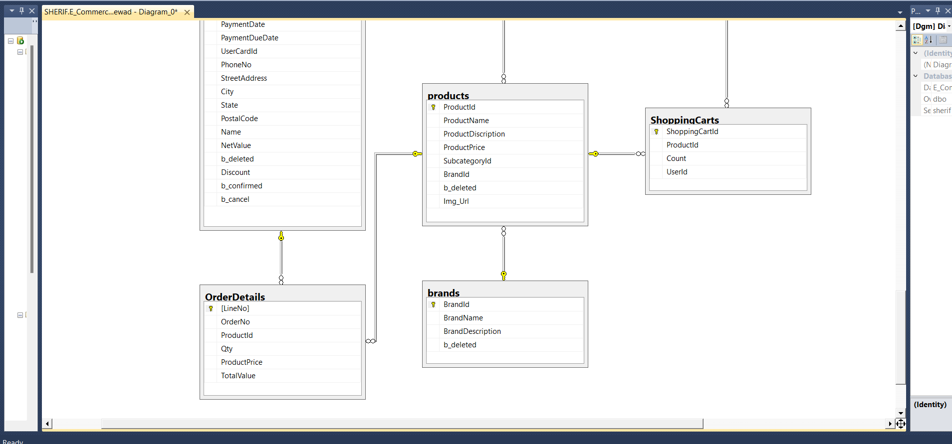

Slide 10
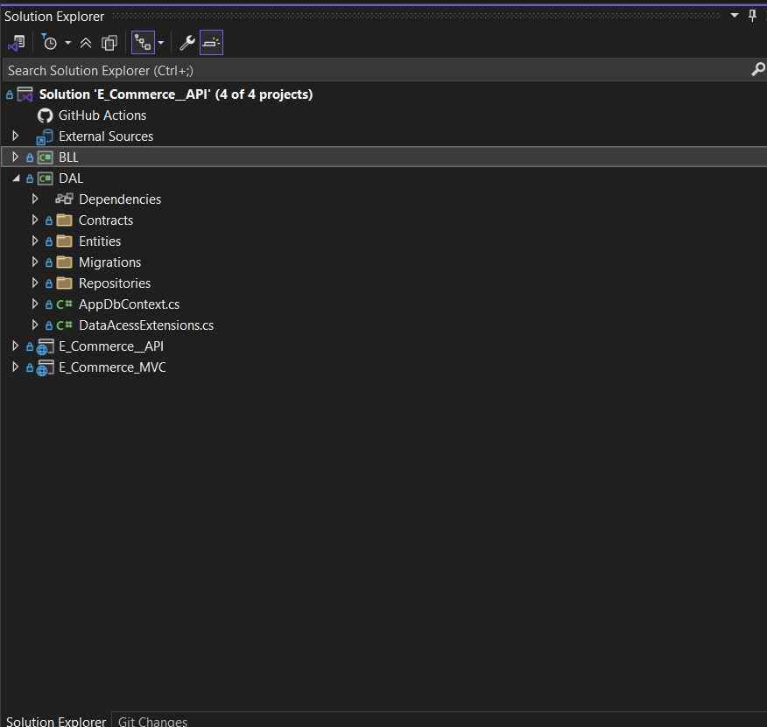
Project structure

Slide 11
Our Vision
Our vision is to build a modern and user-friendly e-commerce platform that offers a fast, simple, and accessible online shopping experience for everyone. Through the power of technology, we aim to deliver high-quality products to our customers and contribute to shaping the future of digital commerce.

Slide 12
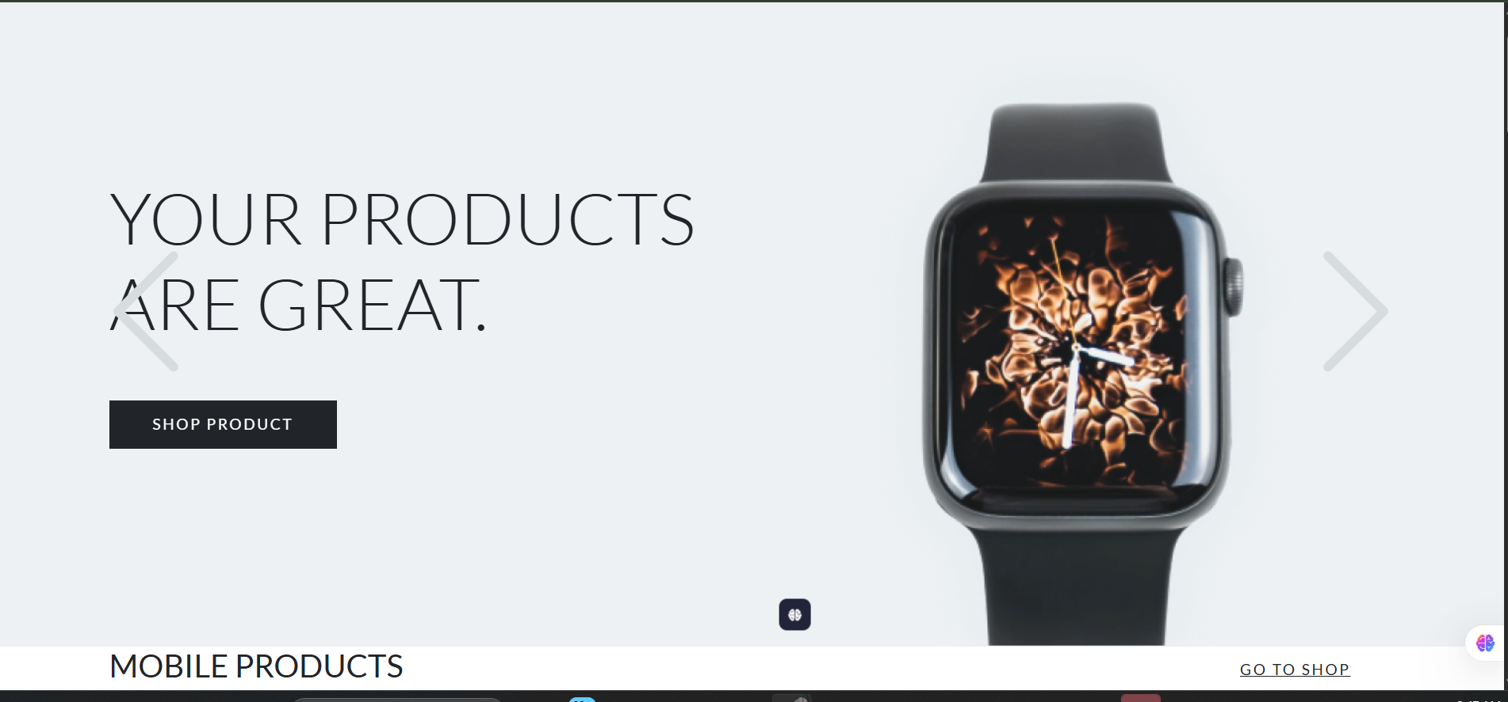

Slide 13
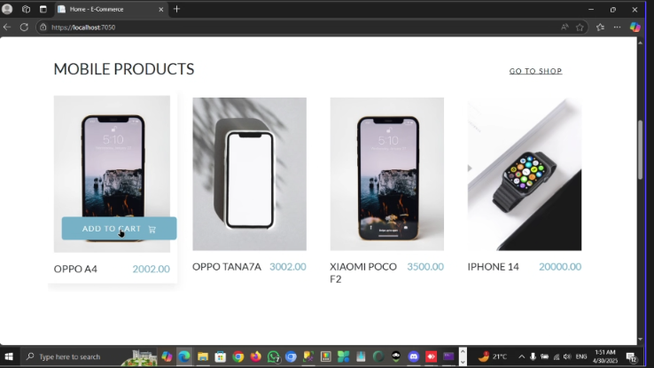

Slide 14
Our Mission
Our mission is to provide a seamless and secure online shopping experience by offering a diverse selection of products, dependable service, and intuitive features, We are dedicated to leveraging technology to connect customers with what they need—anytime, anywhere.

Slide 15
Tecnology stack selection
ASP.NET 8.0 Core MVC Web Framework.
Entity Framework Core.
ASP.NET Core Identity.

Slide 16
Midle wares
JavaScript library for DOM manipulation, AJAX, and event handling
Bootstrap
Frontend framework for responsive design and UI components
Data Tables
Plugin for advanced HTML table interactions
Toastr.Js
Notification library for elegant toast messages
jQuery
SweetAlert
Stylish alert dialog replacement (popup)
TinyMCE
Rich text editor for user content input
SendGrid
Email API for transactional and marketing emails
Stripe
Secure online payment gateway for handling transactions and subscriptions

Slide 17
Middle wares
app. UseHttpsRedirection.
app. UseRouting.
app. UseAuthentication.
app. Usethorization.
app.UseSession.

Slide 18
Live demo
https://github.com/yasserelbalky-Csys/E_Commerce__API.git

Slide 19
Thank you

